Slide 1
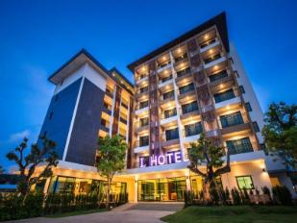

Hotel Reservation Analysis with SQL
by
ADEDOKUN ABDULMALIK ADEYEMI

Slide 2
OVERVIEW
The hotel industry relies on data to make informed decisions and provide a better guest experience. In this project, I work with the hotel reservation dataset to gain insights into guest preferences, booking trends, and other key factors that impact the hotel's operations.
Using SQL to query and analyze the data, as well as answer specific questions about the dataset.

Slide 3
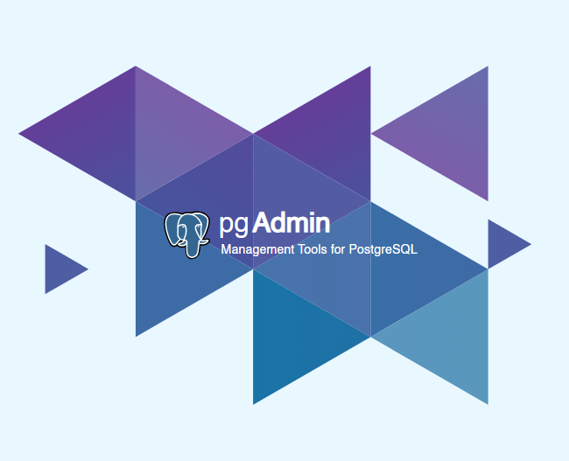
Tool Used
PostgreSQL
PostgreSQL is an open-source relational database management system emphasizing extensibility and SQL compliance.
PostgreSQL features transactions with atomicity, consistency, isolation, durability (ACID) properties, automatically updatable views, materialized views, triggers, foreign keys, and stored procedures.

Slide 4
Dataset Details:
The dataset includes the following columns:
Booking_ID: A unique identifier for each hotel reservation.
no_of_adults: The number of adults in the reservation.
no_of_children: The number of children in the reservation.
no_of_weekend_nights: The number of nights in the reservation that fall on weekends.
no_of_week_nights: The number of nights in the reservation that fall on weekdays.
type_of_meal_plan: The meal plan chosen by the guests.
room_type_reserved: The type of room reserved by the guests.
lead_time: The number of days between booking and arrival.
arrival_date: The date of arrival.
market_segment_type: The market segment to which the reservation belongs.
avg_price_per_room: The average price per room in the reservation.
booking_status: The status of the booking.

Slide 5
PROJECT TASK:
1. What is the total number of reservations in the dataset?
2. Which meal plan is the most popular among guests?
3. What is the average price per room for reservations involving children?
4. How many reservations were made for the year 20XX (replace XX with the desired year)?
5. What is the most commonly booked room type?
6. How many reservations fall on a weekend (no_of_weekend_nights > 0)?
7. What is the highest and lowest lead time for reservations?
8. What is the most common market segment type for reservations?
9. How many reservations have a booking status of "Confirmed"?
10. What is the total number of adults and children across all reservations?
11. What is the average number of weekend nights for reservations involving children?
12. How many reservations were made in each month of the year?
13. What is the average number of nights (both weekend and weekday) spent by guests for each room type?
14. For reservations involving children, what is the most common room type, and what is the average price for that room type?
15. Find the market segment type that generates the highest average price per room.

Slide 6
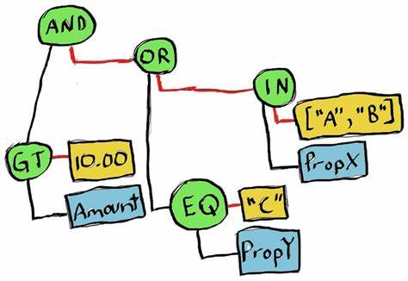
QUERIES >>

Slide 7
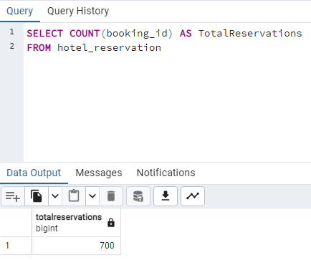
What is the total number of reservations in the dataset?
Ans:
The total number of reservations in the dataset is 700

Slide 8
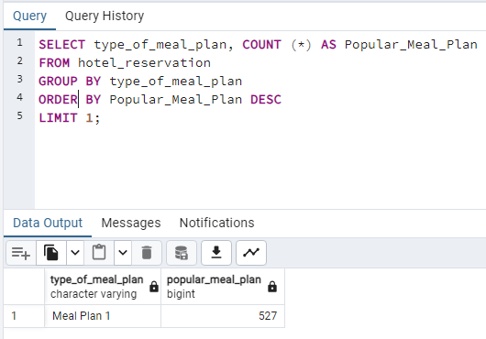
Which meal plan is the most popular among guests?
Ans:
The most popular meal plan among guest is MEAL PLAN 1 which is approximately 527 number of orders.

Slide 9
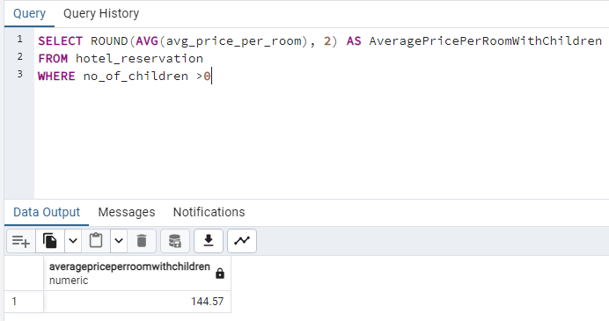
What is the average price per room for reservations involving children?
Ans:
The average price per room for reservations involving children is $144.57

Slide 10
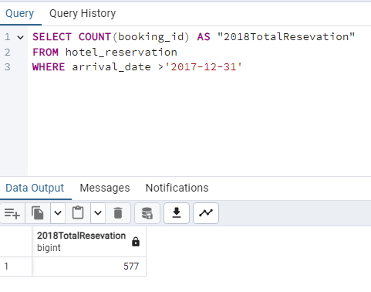
How many reservations were made for the year 2018?
Ans:
Total Reservation that was made in year 2018 is 577

Slide 11
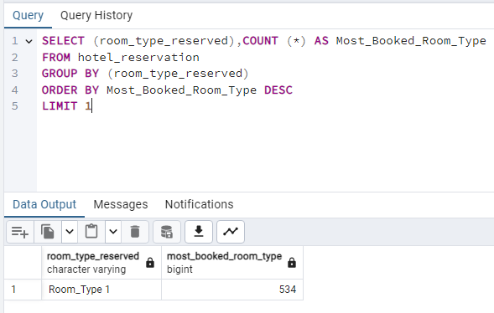
What is the most commonly booked room type?
Ans:
The most commonly booked room type is ROOM_TYPE 1 = 534

Slide 12
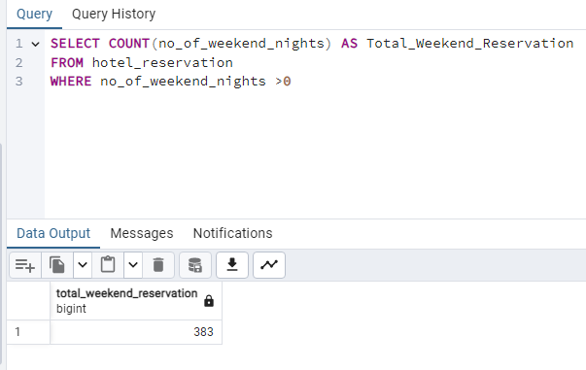
How many reservations fall on a weekend?
Ans:
Total Reservation that fall on Weekend is = 383

Slide 13
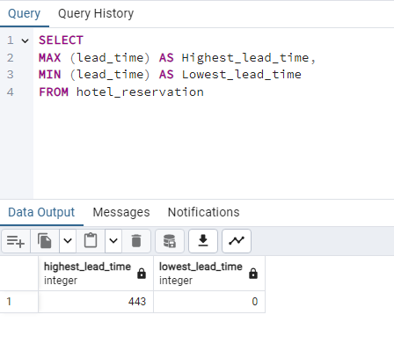
What is the highest and lowest lead time for reservations?
Ans:
The Highest Lead Time is = 383 while the Lowest Lead Time is = 0

Slide 14
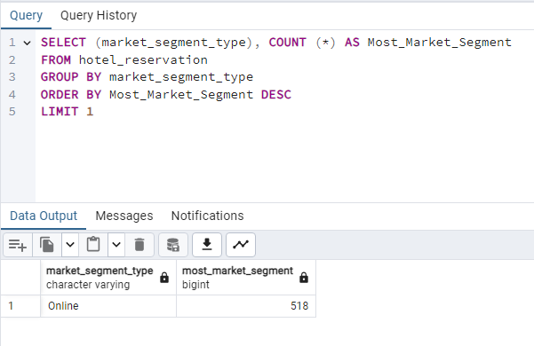
What is the most common market segment type for reservations?
Ans:
The most common market segment type for reservations is = Online which is 518 count of reservation

Slide 15
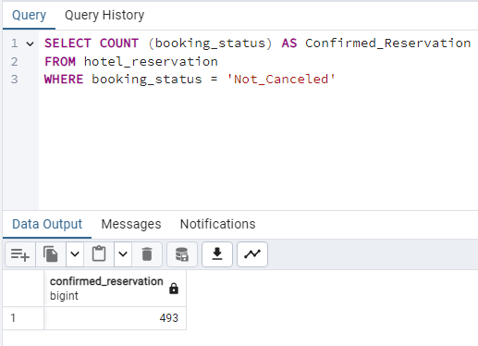
How many reservations have a booking status of "Confirmed"??
Ans:
Total reservation with the booking status “Confirmed” which is = 493

Slide 16
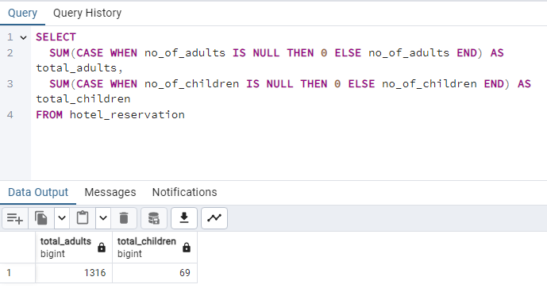
What is the total number of adults and children across all reservations?
Ans:
The total number of adults is = 1,316 and children across all reservations is = 69

Slide 17
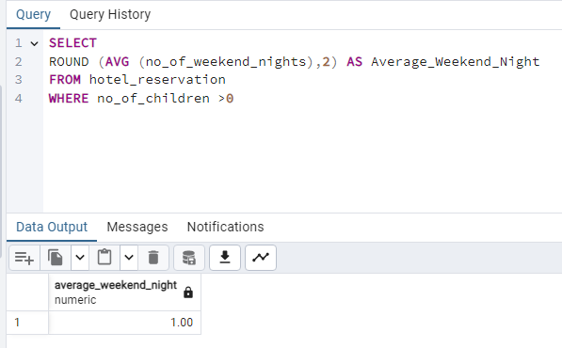
What is the average number of weekend nights for reservations involving children?
Ans:
The average number of weekend nights for reservations involving children is = 1.00

Slide 18
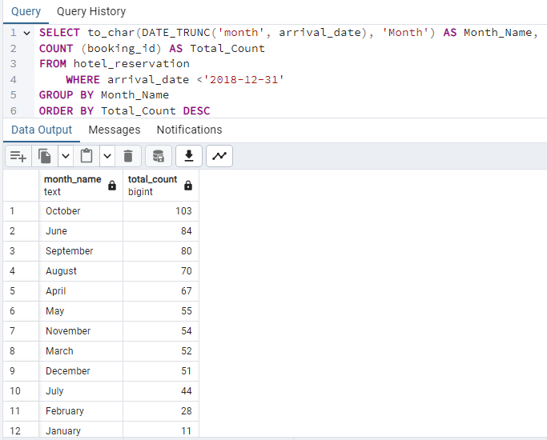
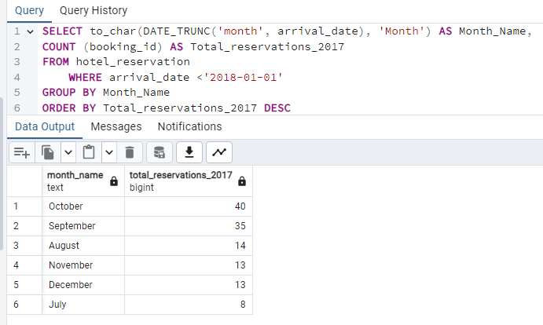
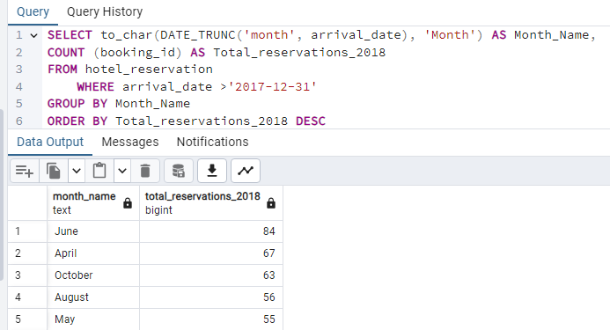
How many reservations were made in each month of the year 2017 & 2018?
2017 RESERVATION
2017 - 2018 RESERVATION
2018 RESERVATION
Ans:
The analyses shows the overall total reservations for each month which OCTOBER takes the lead with = 103 RESERVATIONS

Slide 19
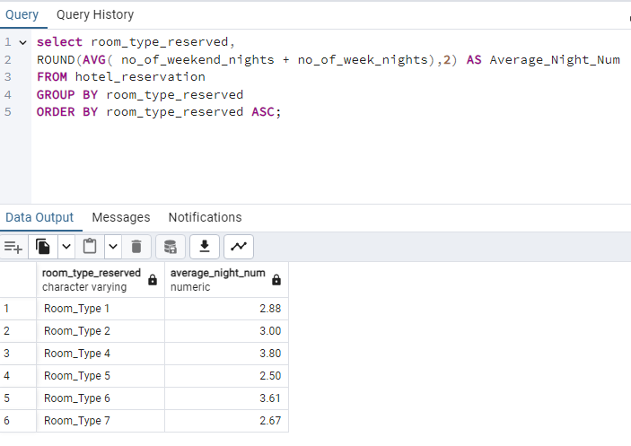
What is the average number of nights (both weekend and weekday) spent by guests for each room type?
Ans:
The average number of nights for both weekend and weekday

Slide 20
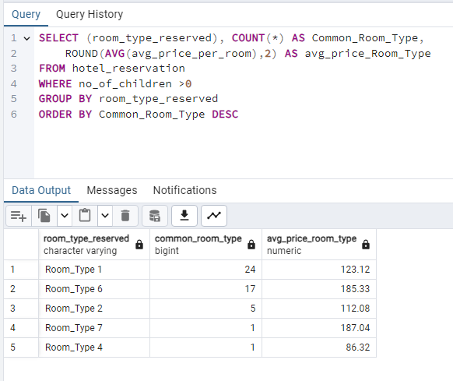
For reservations involving children, what is the most common room type, and what is the average price for that room type?
Ans:
Result shows The average price per room type and most common room type from highest to lowest

Slide 21
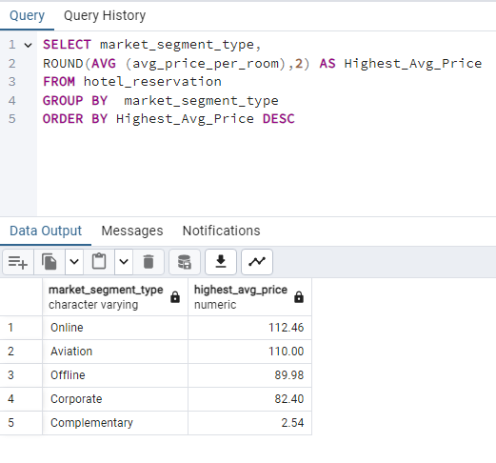
Find the market segment type that generates the highest average price per room?
Ans:
The market segment type that generates the highest average price per room is ONLINE = $112.46

Slide 22
CONCLUSION
This hotel reservation dataset analysis provided valuable insights into guest booking trends. Here are the key takeaways:
I identified the overall reservation volume and popular meal plans.
I analyzed pricing trends for rooms with children and reservations made during specific years.
I determined the most frequently booked room type and weekend stay patterns.
I explored lead times, booking statuses, market segments, and guest demographics.
I investigated the relationship between room type, children, and pricing for reservations.
I pinpointed the market segment generating the highest average room revenue.
This information can be used to:
Optimize room pricing strategies based on room type, market segment, and guest preferences.
Develop targeted marketing campaigns for specific guest demographics and popular booking periods.
Improve resource allocation by understanding lead times and weekend booking trends.
Identify areas for improvement in guest experience based on market segment analysis.
By leveraging these insights, the hotel can make data-driven decisions to increase revenue, enhance guest satisfaction, and achieve operational efficiency

Slide 23
THANK
YOU
ADEDOKUN ABDULMALIK ADEYEMI

